Slide 1

Name-Neelotpal Chowdhury
Registration no.-12104606
Section-K21WN
Roll no.-RK21WNA17
Course code-INT219
Project Name-Hotel Website

Slide 2
Table of Contents:-
--Revision History--
--Client Approval--
1.Introduction-
1.1.Purpose
1.2.Scope
1.3.Definitions,Acronyms and Abbreviations
1.4.References
1.5.Overview
2.General Description-
2.1.Product Perspective
2.2.Product Functions
2.3.User Characteristics
2.4.General Constraints
2.5.Assumptions and Dependencies
3.Specific Requirements-
3.1 External Interface Requirements
3.1.1 User Interfaces
3.1.2 Hardware Interfaces
3.1.3 Software Interfaces
3.1.4 Communications Interfaces
3.2 Functional Requirements
3.5 Non-functional Requirements
3.5.1 Performance
3.5.2 Reliability
3.5.3 Availability
3.5.4 Security
3.5.5 Maintainability
3.5.6 Portability
3.7 Design Constraints
3.9 Other Requirements
--Analysis Models-data Flow Diagrams (DFD)--
--Appendices--

Slide 3
REVISION HISTORY:-
Date | Description | Author | Comments
01-03/10/2023 | Home page | Neelotpal Chowdhury | Successful
04-06/10/2023 | About Us page | Neelotpal Chowdhury | Successful
07-10/10/2023 | Services page | Neelotpal Chowdhury | Successful
11-14/10/2023 | Menu page | Neelotpal Chowdhury | Successful
15-19/10/2023 | Order page | Neelotpal Chowdhury | Successful
20-24/10/2023 | Documentation | Neelotpal Chowdhury | Done

Slide 4
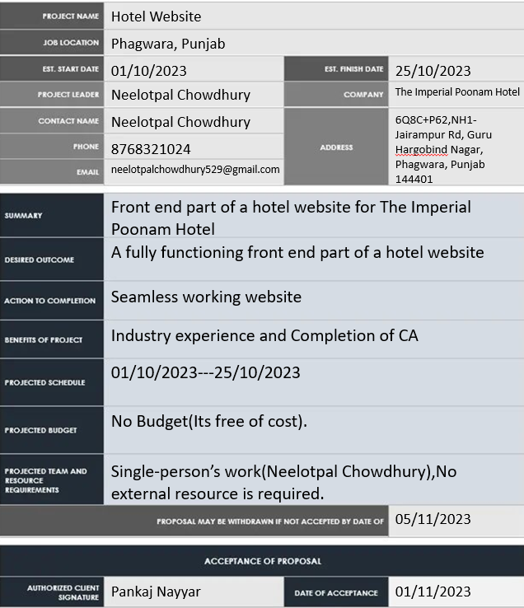
CLIENT APPROVAL:-

Slide 5
SRS Document
Hotel Website:-
1. Introduction-
The Hotel Website is an online platform designed to showcase the hotel's menu, ambiance, location, and other relevant information to potential customers. This website aims to improve the accessibility of information for patrons and provide a seamless experience for online reservations and ordering.
1.1. Purpose
The purpose of this document is to outline the requirements for the development of the hotel website. It serves as a reference for the design and implementation process, ensuring that the website meets the expectations of users, hotel management, and stakeholders.
1.2. Scope
The hotel website will focus on providing users with the following key features:
Detailed menu with item descriptions, pricing, and dietary information
Online reservation system for booking tables
Seamless online ordering system for takeout and delivery
Information about the restaurant's location, hours of operation, and contact details
User-friendly interface for easy navigation and accessibility across devices
1.3. Definitions, Acronyms, and Abbreviations
CMS: Content Management System
UI: User Interface
UX: User Experience
POS: Point of Sale
API: Application Programming Interface
SEO: Search Engine Optimization
1.4. References
(Insert relevant references here, such as other related documents, websites, or standards used in the development process.)
1.5. Overview
The hotel website will serve as a digital gateway for customers to explore the hotel's offerings and make reservations or place orders conveniently. It will prioritize an engaging and user-friendly interface, ensuring that the menu and ordering process are clear and intuitive. Additionally, the website will integrate secure payment gateways and communication channels to provide a seamless and enjoyable experience for customers.

Slide 6
2. General Description-
The hotel website is an online platform developed to provide comprehensive information about the hotel's menu, services, location, and other relevant details to potential customers. It is designed to streamline the process of table reservations and facilitate online food ordering for takeout and delivery. The website aims to enhance user experience and accessibility, ensuring a seamless and convenient interaction for both customers and hotel staff.
2.1. Product Perspective
The Restaurant Website will function as an integral part of the restaurant's overall business strategy. It will be linked with the restaurant's internal management system, including inventory management, order processing, and customer relationship management, to ensure a seamless and efficient operation. The website will also integrate with the restaurant's payment processing system and potentially with third-party delivery services to manage online orders effectively.
2.2. Product Functions
The key functions of the restaurant website include:
Displaying an interactive and visually appealing menu with item details and prices.
Facilitating online reservations for dining at the restaurant.
Enabling online food ordering for takeout and delivery.
Providing information about the restaurant's location, hours of operation, and contact details.
Offering a user-friendly interface that is responsive across various devices.
Allowing customers to provide feedback and reviews about their dining experiences.
2.3. User Characteristics
The users of the restaurant website include:
Customers looking for information about the restaurant's menu, location, and services.
Individuals interested in making online reservations for dining at the restaurant.
Customers seeking to place orders for takeout or delivery.
Restaurant staff responsible for managing and fulfilling reservations and orders.
2.4. General Constraints
The development of the restaurant website must adhere to the following constraints:
Compliance with data protection and privacy regulations.
Integration with a secure payment gateway for online transactions.
Compatibility with various web browsers and devices.
Adherence to the restaurant's branding guidelines and visual identity.
2.5. Assumptions and Dependencies
The development of the restaurant website is based on the following assumptions and dependencies:
Availability of a stable internet connection for users accessing the website.
Integration with a reliable web hosting service for data storage and management.
Accessibility to a secure online payment processing system for handling transactions.

Slide 7
3. Specific Requirements
3.1 External Interface Requirements
3.1.1 User Interfaces
The user interface should be intuitive and visually appealing, providing easy navigation for customers to explore the menu, make reservations, and place orders.
The interface should be responsive and accessible across various devices, including desktops, laptops, tablets, and smartphones.
3.1.2 Hardware Interfaces
The website should be compatible with standard hardware configurations, including common web browsers and mobile devices.
3.1.3 Software Interfaces
The website should integrate with the restaurant's internal systems, including the point of sale (POS) system, inventory management software, and customer relationship management (CRM) tools.
3.1.4 Communications Interfaces
The website should support secure communication protocols for handling online transactions and customer data.
3.2 Functional Requirements
3.2.1 Online Menu Display
The website should display the restaurant's menu, including categories, item descriptions, prices, and dietary information.
3.2.2 Reservation Management
Customers should be able to view the restaurant's availability and make table reservations online.
3.2.3 Online Ordering System
The website should allow customers to place orders for takeout and delivery, including selecting menu items, specifying customizations, and making payments.
3.5 Non-functional Requirements
3.5.1 Performance
The website should load quickly and respond to user interactions promptly, even during peak traffic hours.
3.5.2 Reliability
The website should be reliable and available for use 24/7, with minimal downtime for maintenance or updates.
3.5.3 Availability
The website should have a high uptime percentage, ensuring that customers can access the website and its services without interruptions.
3.5.4 Security
The website should implement robust security measures to protect user data, transactions, and sensitive information.
3.5.5 Maintainability
The website should be designed with clean and modular code, making it easy for developers to maintain and update the system.
3.5.6 Portability
The website should be compatible with various operating systems and devices, ensuring a seamless user experience across different platforms.

Slide 8
3.7 Design Constraints
The website design should comply with the restaurant's branding guidelines and visual identity.
The user interface design should be consistent and coherent throughout the website.
3.9 Other Requirements
The website should provide multilingual support to accommodate customers from diverse language backgrounds.
The website should comply with the accessibility guidelines to ensure that it is usable by people with disabilities.
References:-
1. https://www.w3schools.com/
2. https://www.geeksforgeeks.org/

Slide 9
Analysis Model:-
Flow Chart→
Home
About Us
Sign-in
Login
Services
Menu
Order

Slide 10
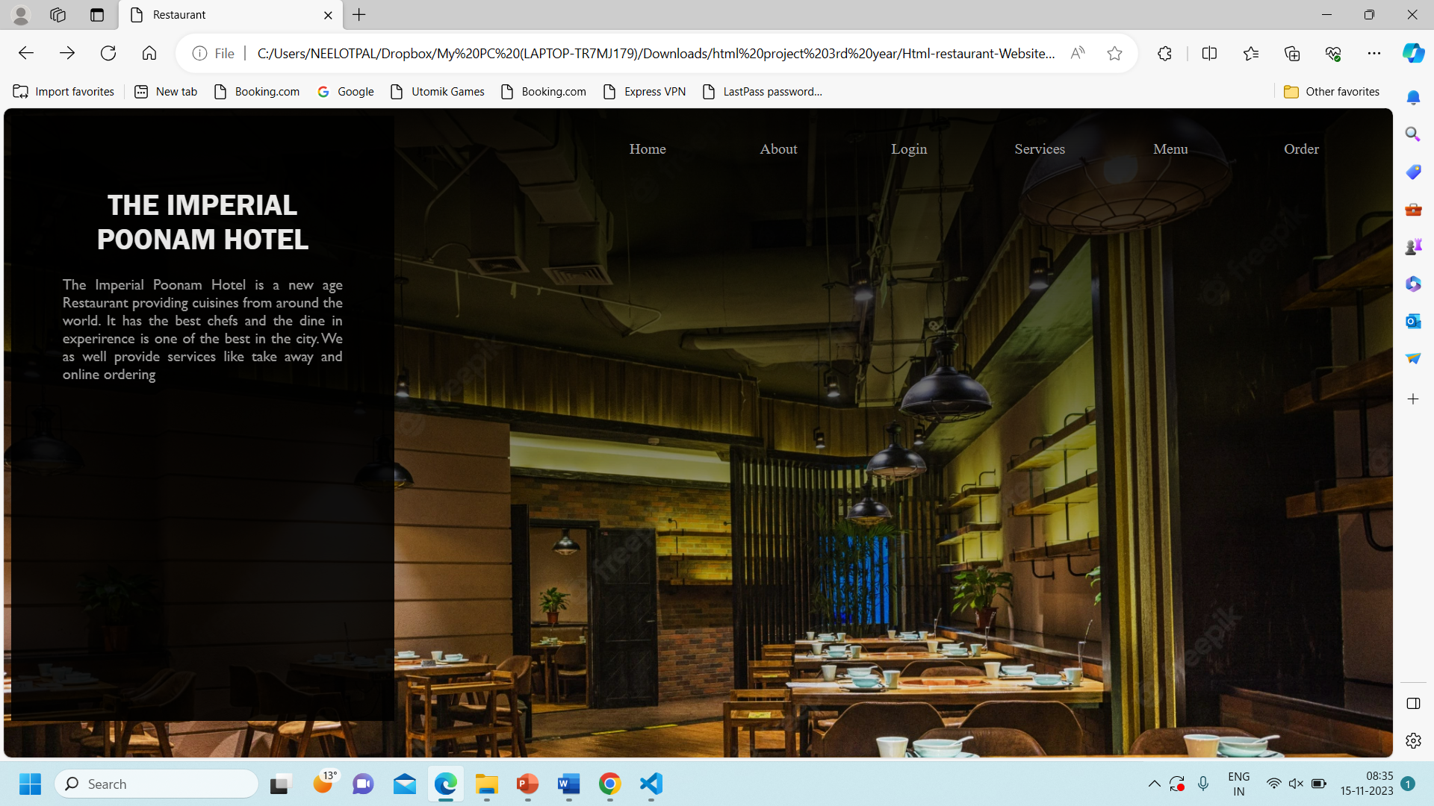
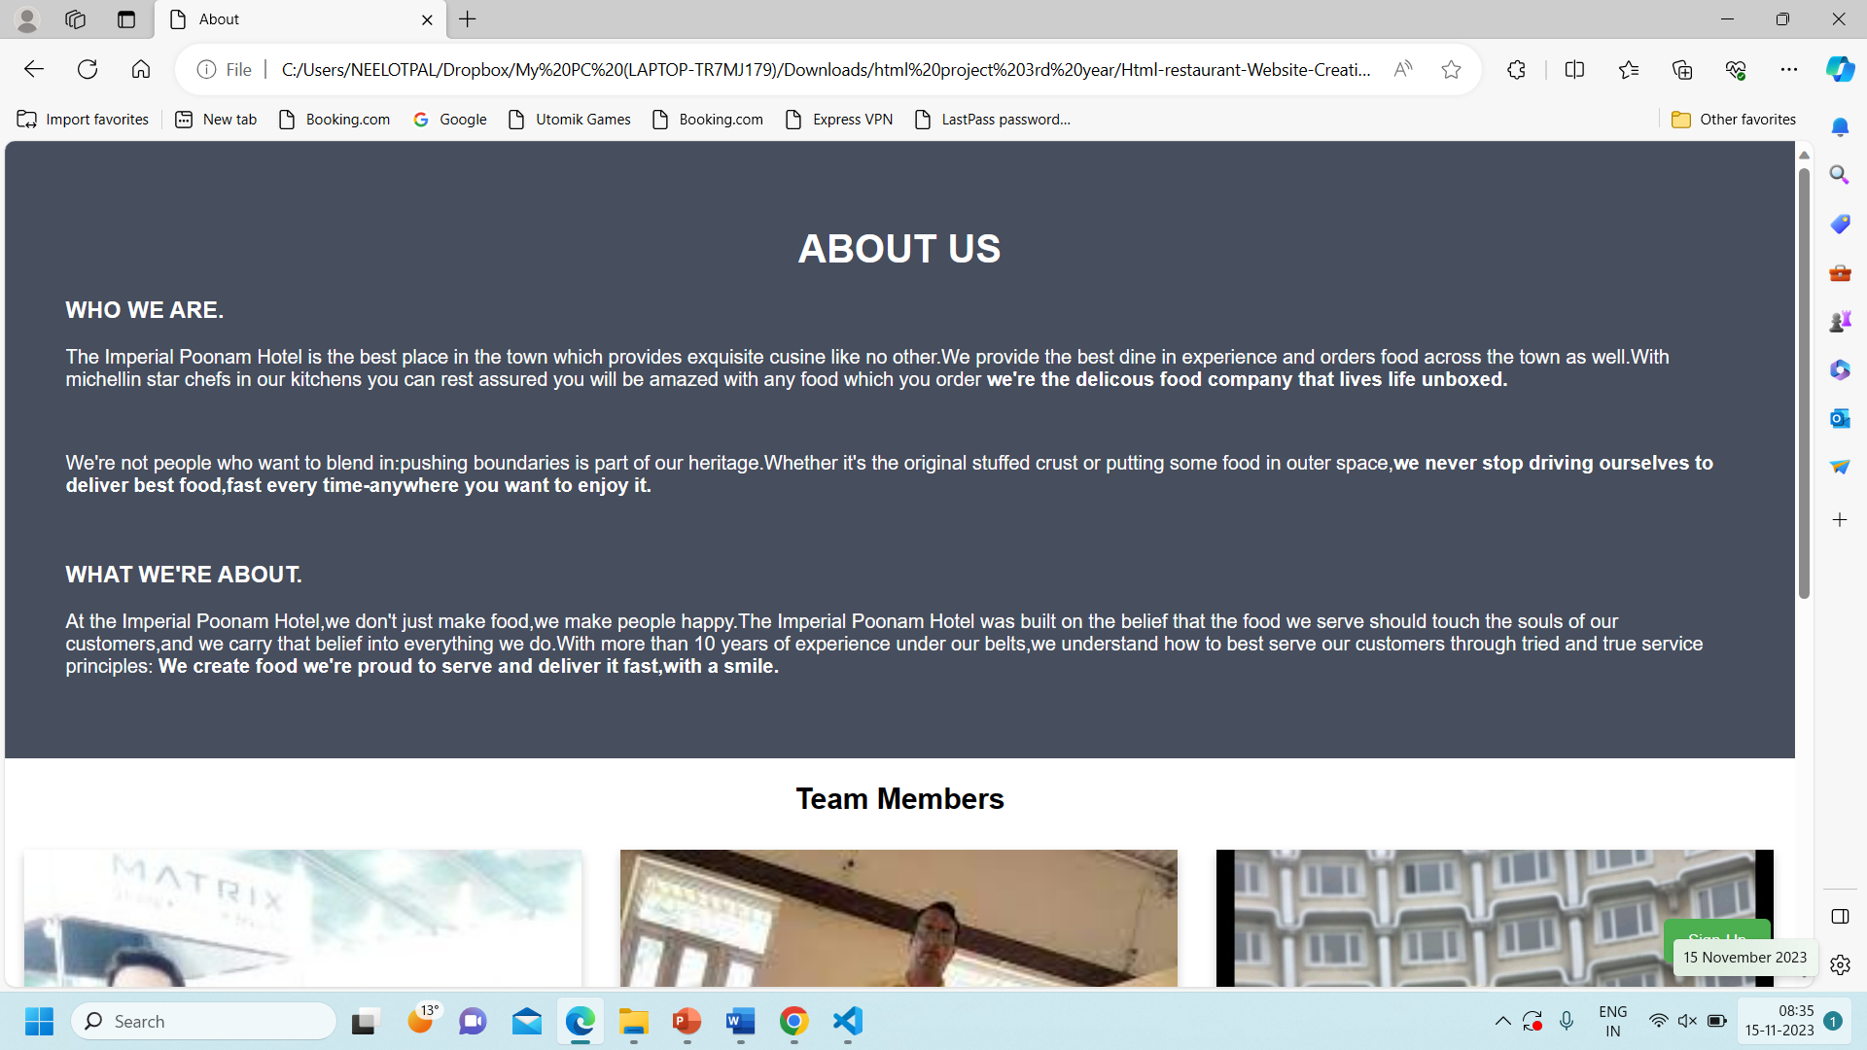
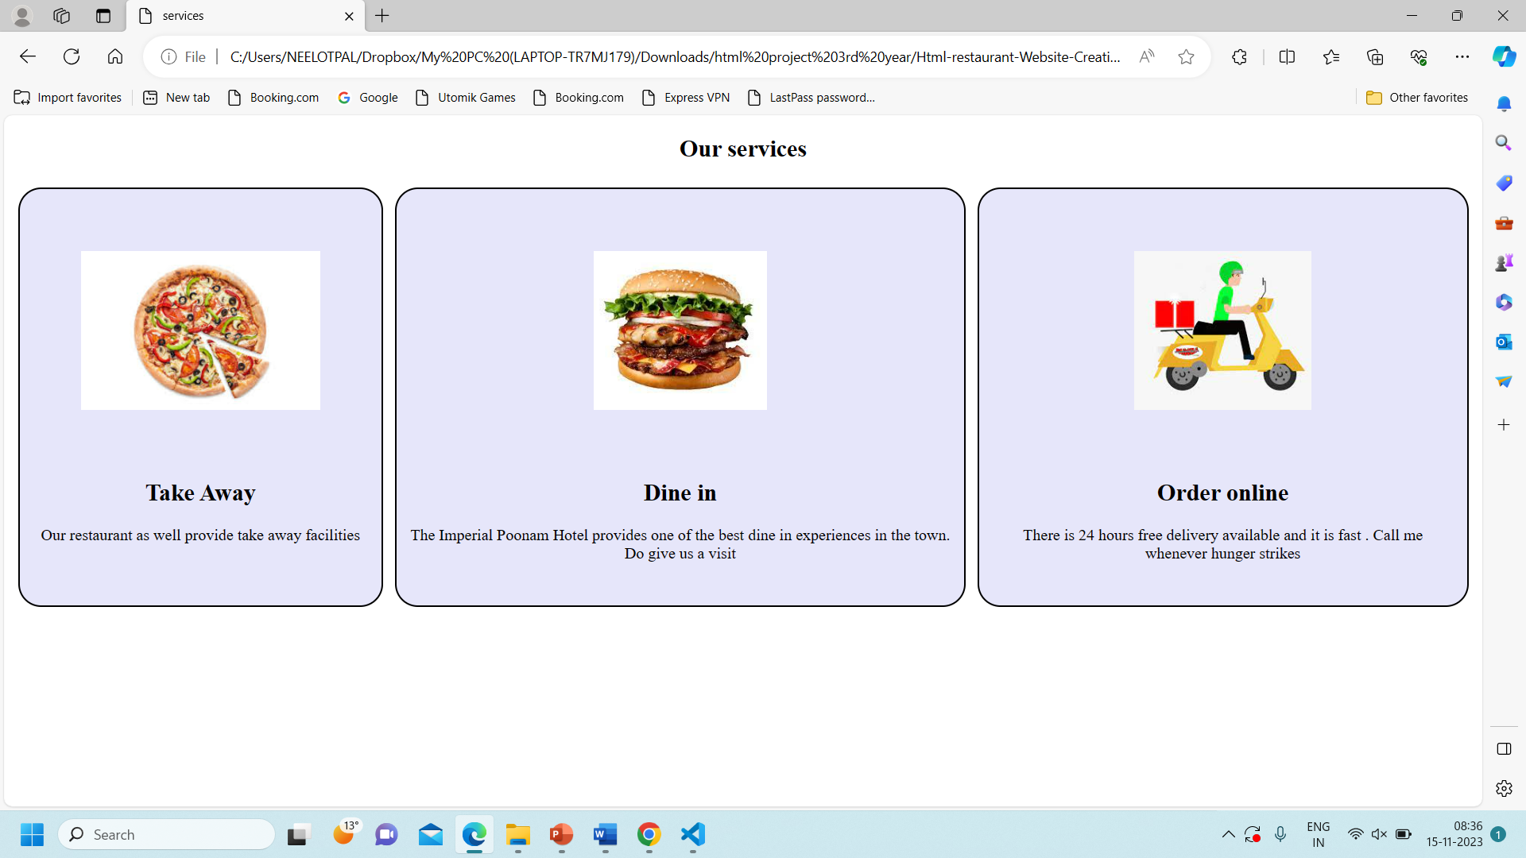
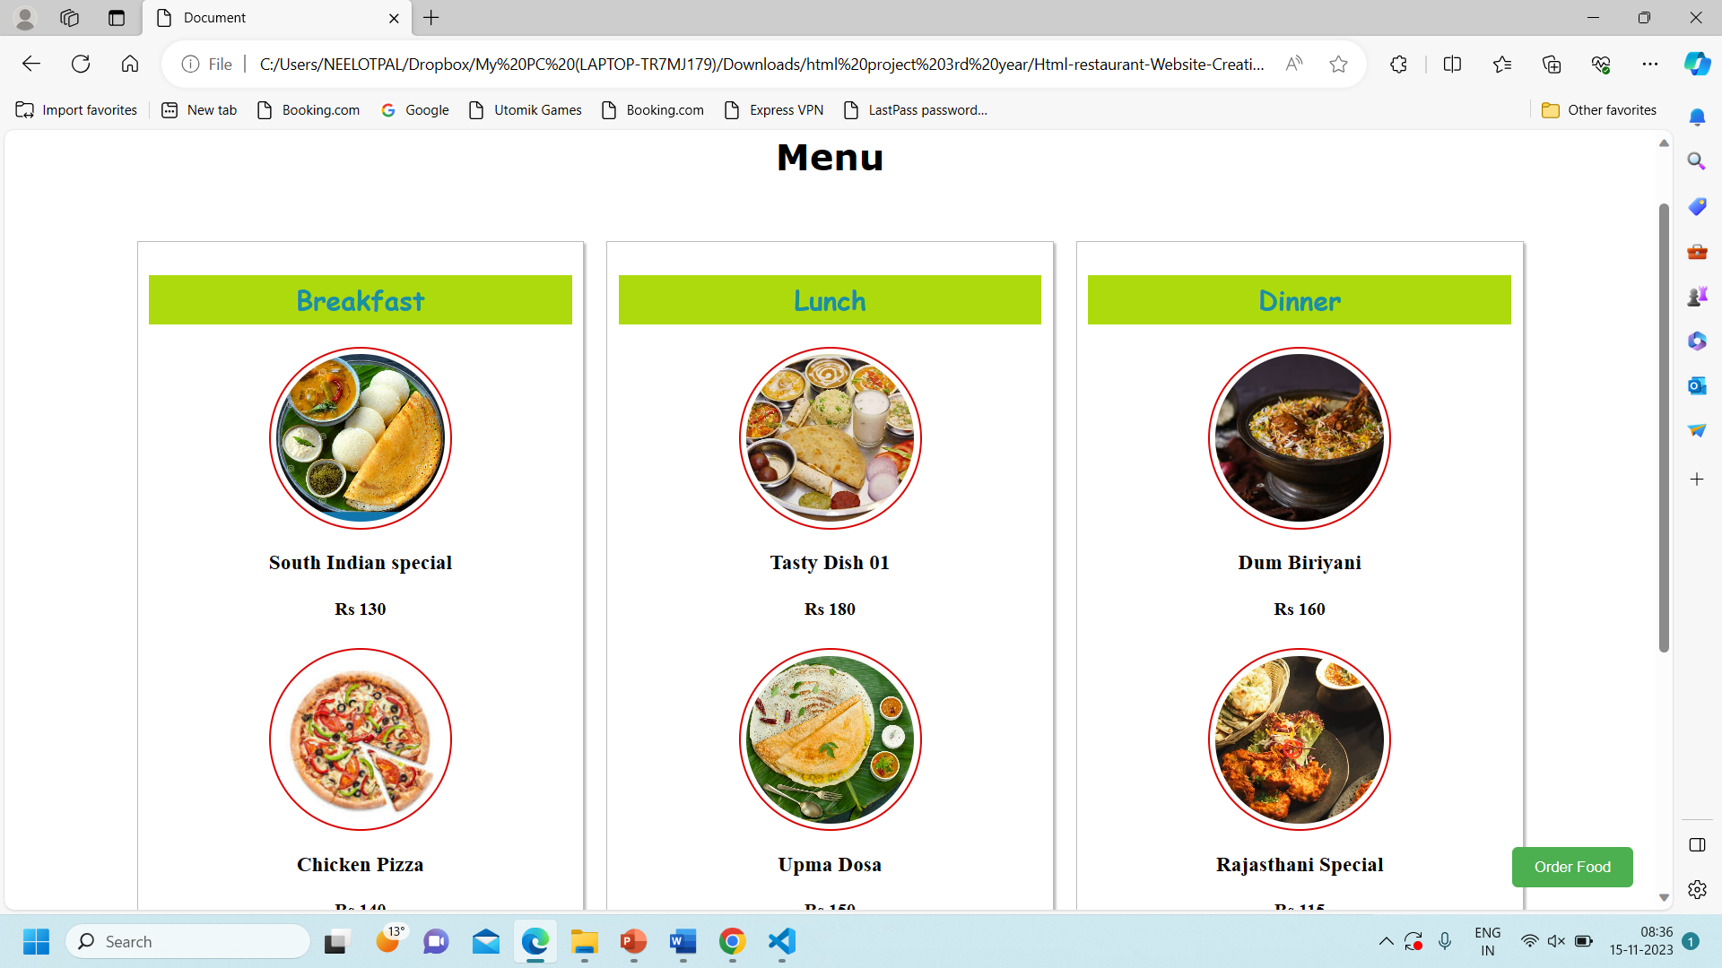
Appendices:-
About Us Page
Home Page
Services Page
Menu Page

Slide 11
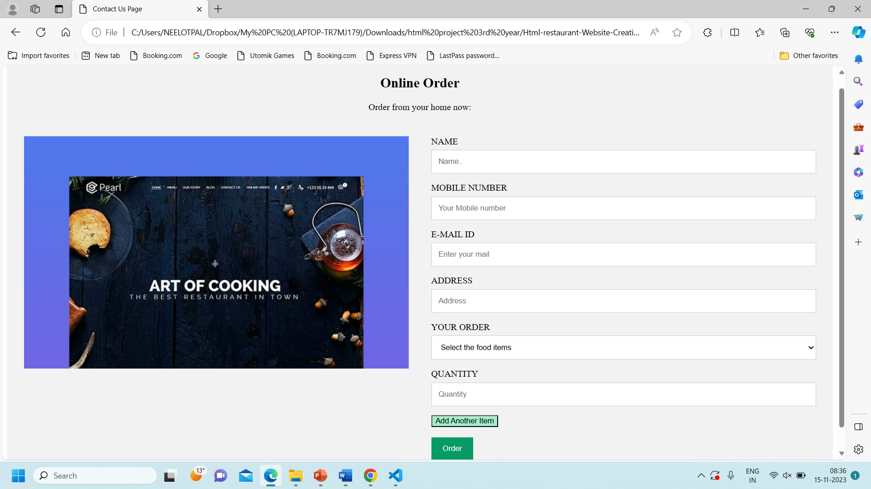
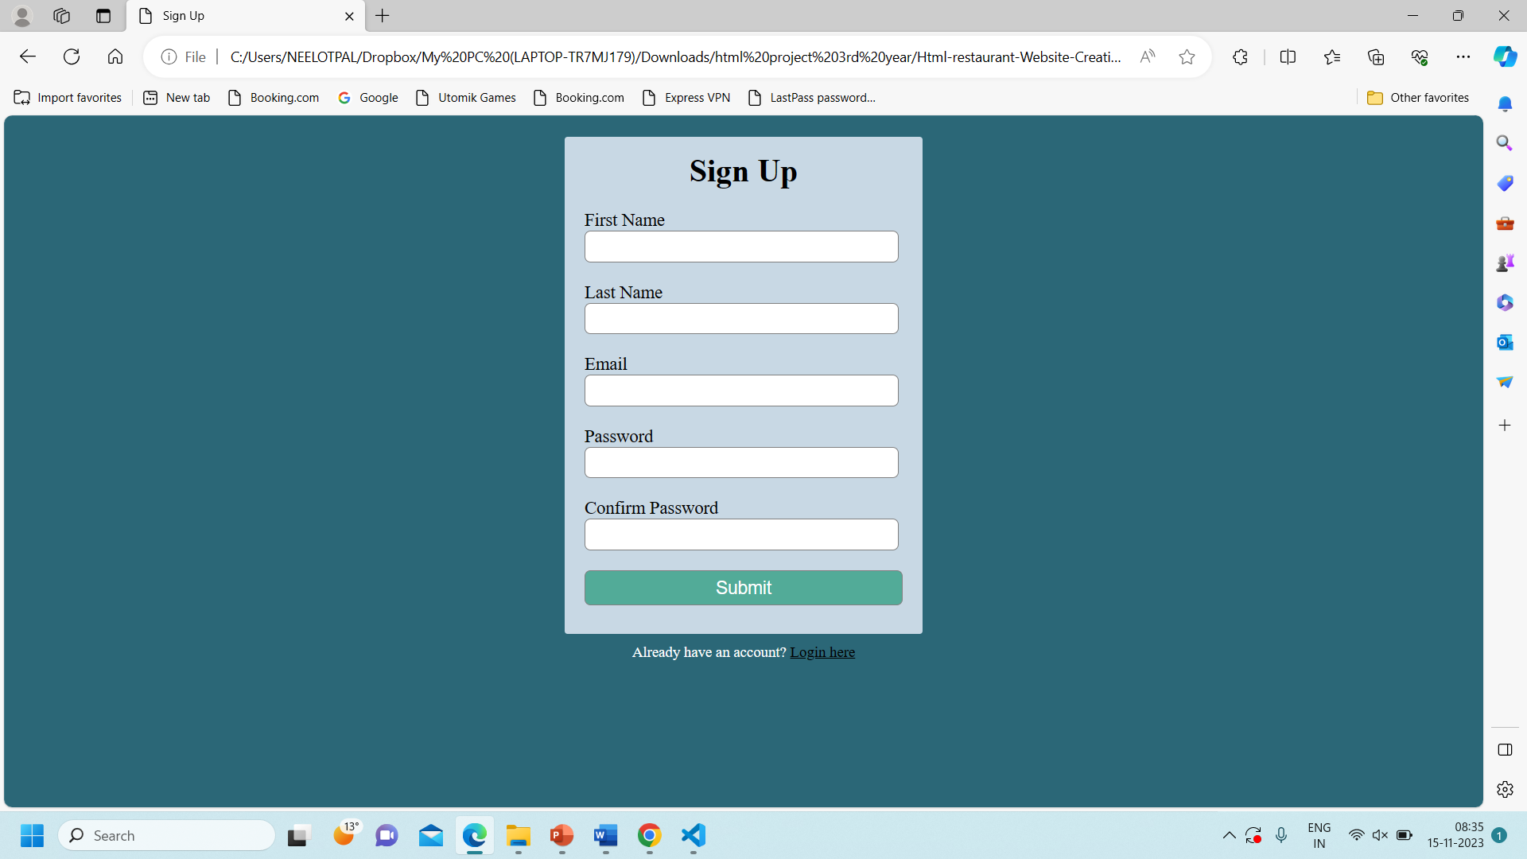
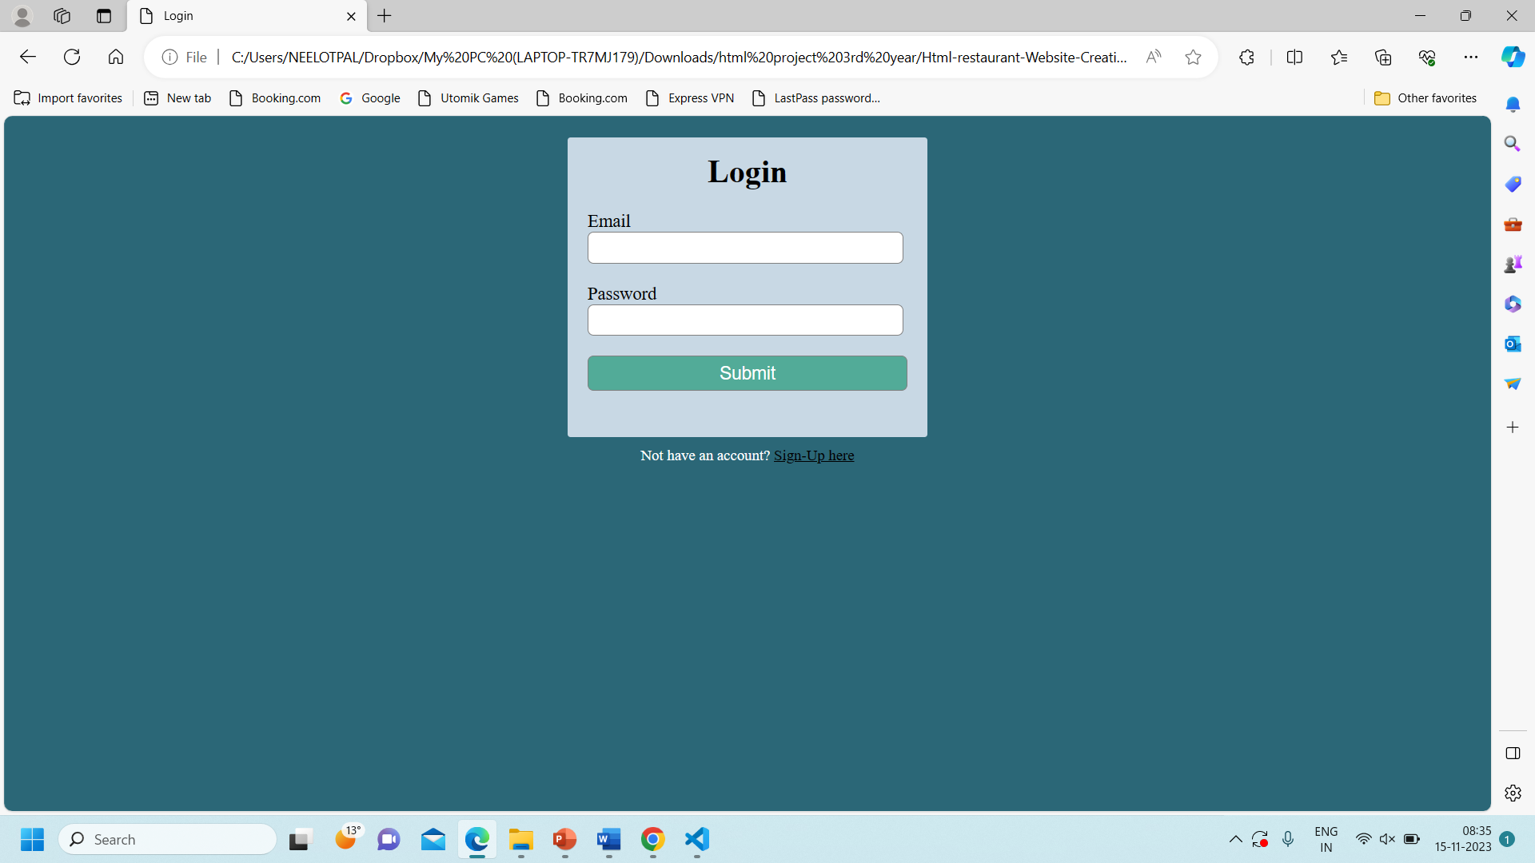
Order Page
Sign-in Page
Login Page

